Slide 1
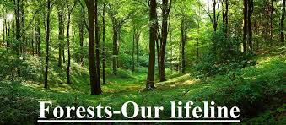

Slide 2
Learning Outcomes:
Able to understand about the composition of forest.
Can understand the characteristics of trees in the forest.
They will be able to know how plants maintain the balance of oxygen and carbon dioxide.
Can also explain about the food chain.
Able to define the meaning of deforestation.
They will understand the importance of forest in our daily life.

Slide 3
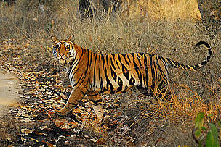
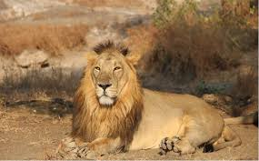
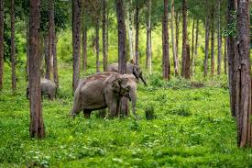
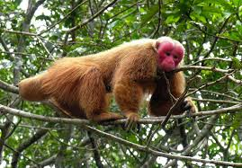
Introduction:
Forest is a natural habitat for different kinds of plants and animals. They provide food and shelter for animals.
Some common animals found in the forest are lion, tiger, elephant, monkey, deer, snake, zebra, jackal, etc.

Slide 4
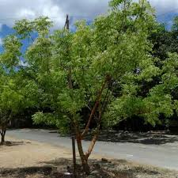
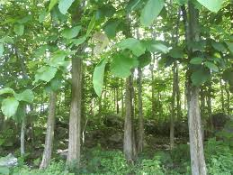
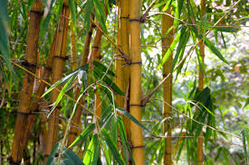
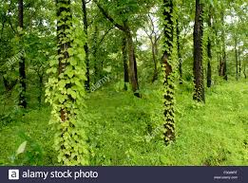
Forest has several kinds of trees, shrubs , herbs, climbers and creepers. Common plants include- teak, bamboo, neem, amla,Sal etc.
Neem
Forest floor and trees were
covered with creepers and
climbers.

Slide 5
Components of Forest:
Forest has different types of plants and animals.
Autotrophs-They are the green plants which can prepare their own food.
Heterotrophs-They are the animals which get their food directly or indirectly from plants.
Saprotrophs- Organisms which feed on dead and decay materials and convert into humus.

Slide 6
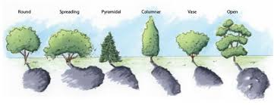
Characteristics of the trees in forests
The branchy part of a tree above the stem is called Crown of the tree.
Trees have crown of different shapes and sizes.These has created different horizontal layers in the forest. These are known as Understorey.

Slide 7
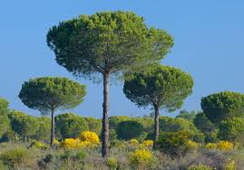
The branches of tall trees look like roof over the other plants in the forest. This is called Canopy.

Slide 8
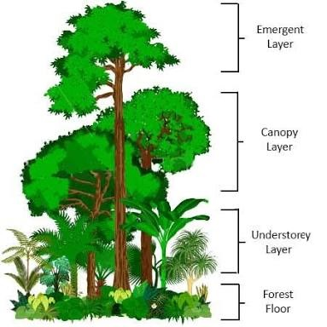

Slide 9
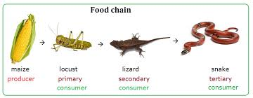
Organisms which feed on plants often get eaten other organisms and so on to form Food Chain.
There are many food chains in the forest. All the food chains are linked together.
If any food chain is disturbed it affects other food chains.

Slide 10
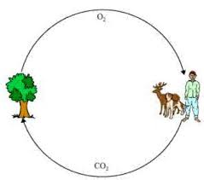
Balance of Oxygen and Carbon Dioxide in the
atmosphere:
During respiration plants and
animals take in oxygen and
release carbon dioxide.
During photosynthesis
plants take in carbon-
dioxide and release oxygen.
So,plants help to maintain the
oxygen and carbon –dioxide balance in the
atmosphere.This is why forests is
called Green Lungs.

Slide 11
Forest is a ‘Dynamic Living Entity’, full of
life and vitality.
Forest harbours variety of plants providing
food for herbivores.
Larger number of herbivores means
increased availability of food for carnivores.
Decomposers help in maintaining supply of
nutrients to the soil.
Greater biodiversity of organisms helps the
forest to regenerate and grow.

Slide 12
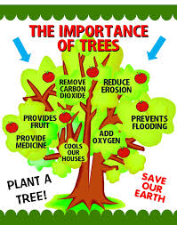

Slide 13
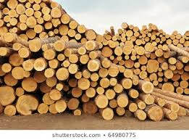
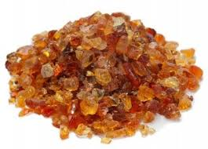
Some forest products:
Timber
Gum
Paper
Honey

Slide 14
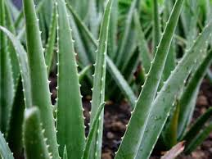
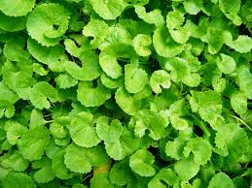
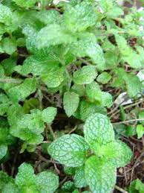
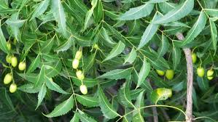
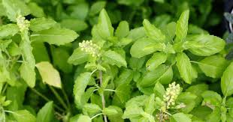
Some medicinal plants:
Aloe vera
Indian Pennywort
mint
neem
Tulsi

Slide 15
Summary:
Forest is a natural habitat for a large number
of plants and animals.
Forest help in maintaining oxygen and carbon -dioxide balance in the atmosphere.
Forest help in bringing good rainfall.
Forest absorb rainwater and helps to maintain water table.
Forest prevents from soil erosion.
Forests provide medicines, timber and many
other useful products.

Slide 16
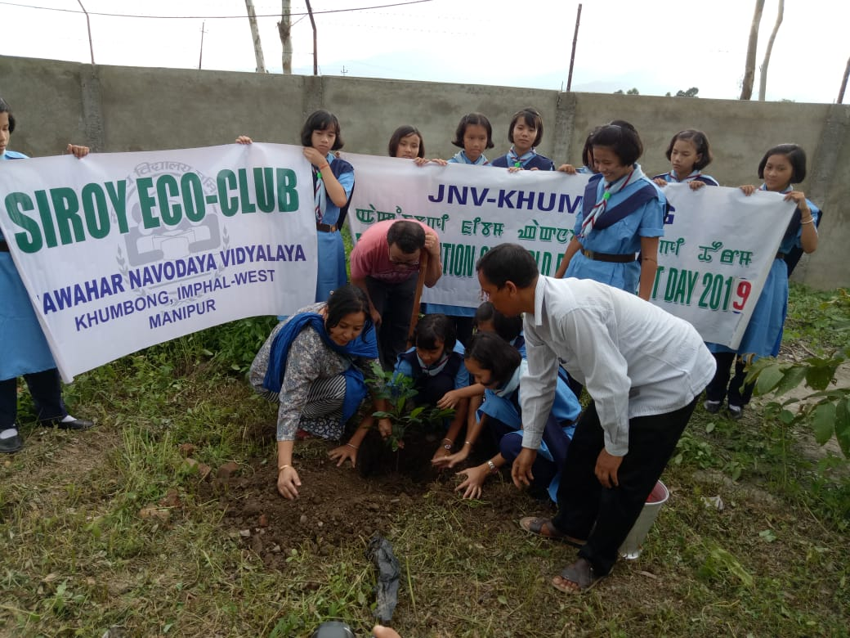

Slide 17
THANK YOU

